Slide 1

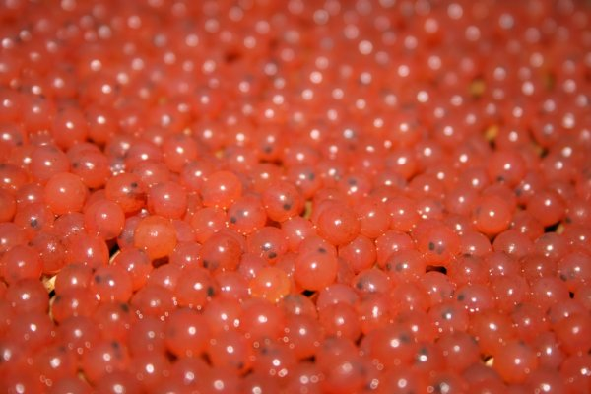
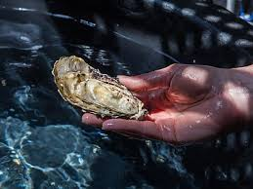
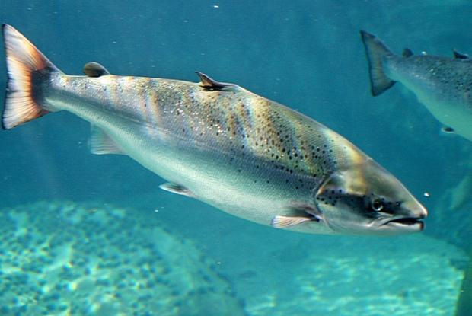
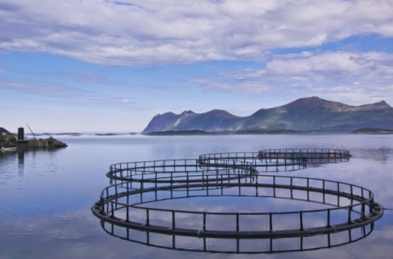
GRINNAQUA – GENOMICS WORKSHOP
Porto, 16th & 17th March 2023

Slide 2
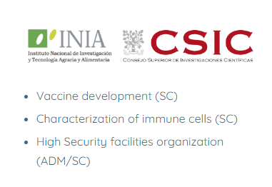
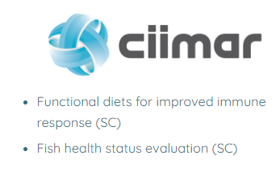
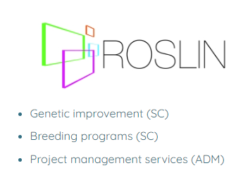
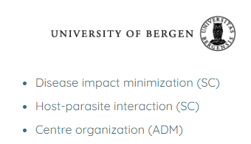
GRINNAQUA – a Twinning Network funded by the EU Horizon Widera programme

Slide 3
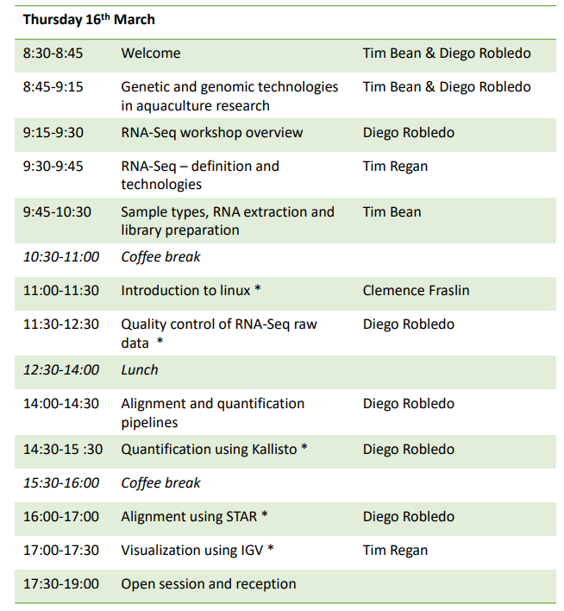
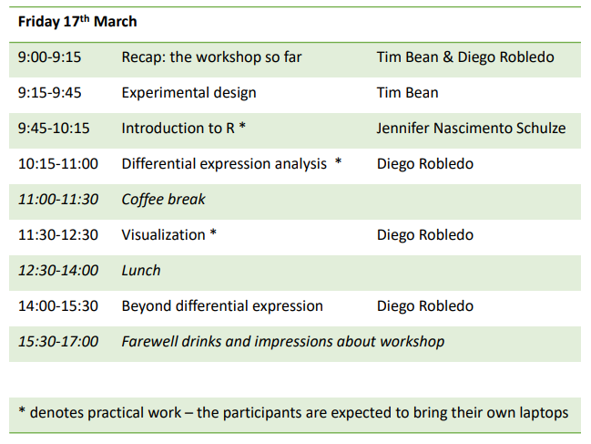
Workshop – Increasing researcher’s skills on the use of omics tools

Slide 4
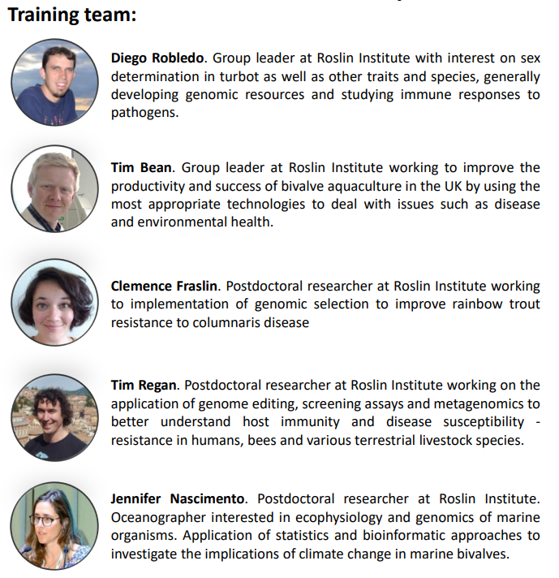
Workshop – Increasing researcher’s skills on the use of omics tools

Slide 5
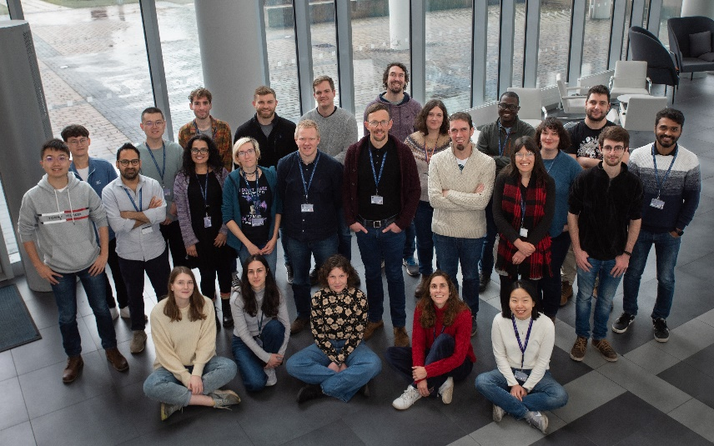
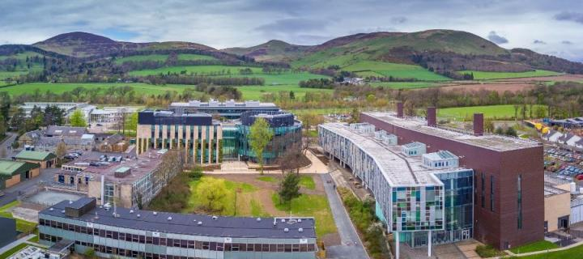
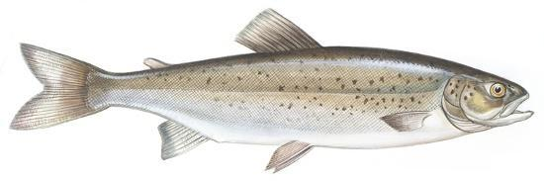
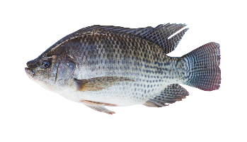
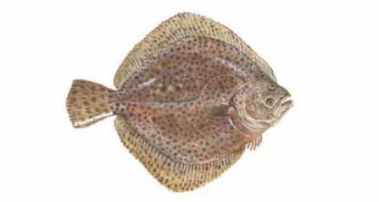
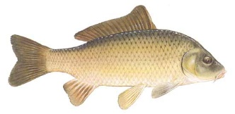
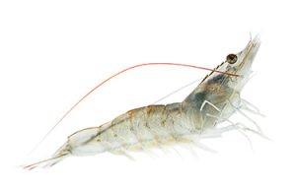
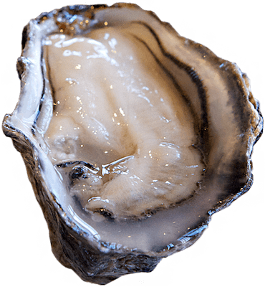
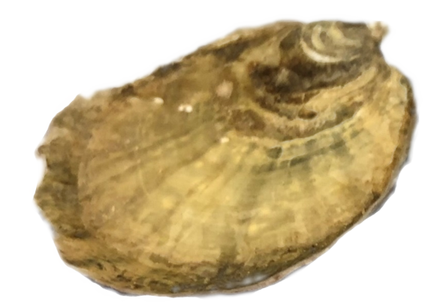
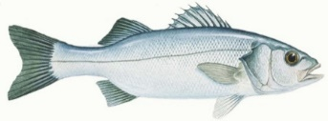
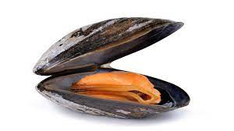
Roslin aquaculture - An expanding team focussing on Aquaculture Genetics & Health
4
Group leaders
14
Postdoctoral research fellows
15
PhD students
12
Visitors in 2022

Slide 6
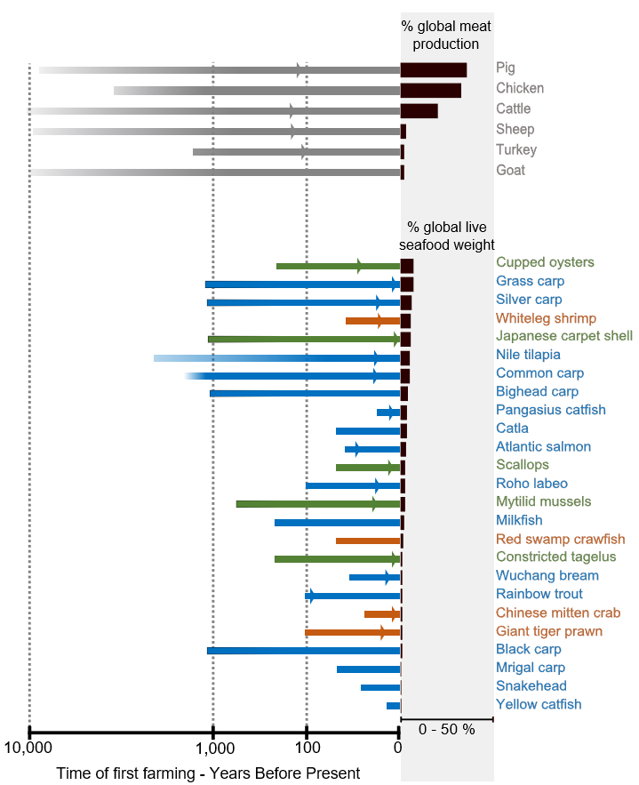
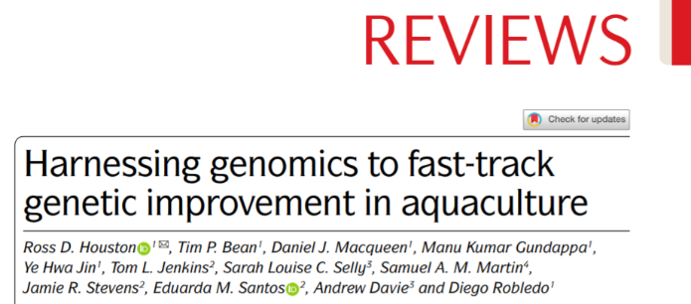
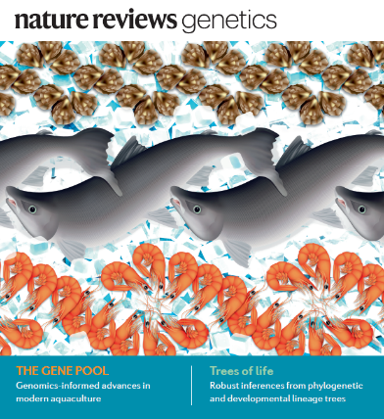
Genetics in Aquaculture
Domestication of aquaculture species is recent and ongoing
Huge potential for genetic improvement diverse species
Major but under recognised role in sustainable expansion
Aquaculture will soon undergo a genetics revolution
Uptake of selective breeding and biotechnologies
Enabled by data-driven genomics and phenotyping
Newly farmed species benefit from sharing of technology
Houston et al (2020), Nature Reviews Genetics, 21:389-409
(Arrows denote time of first known breeding programmes)

Slide 7
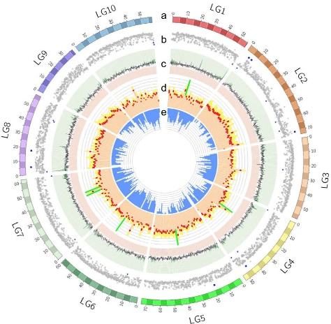
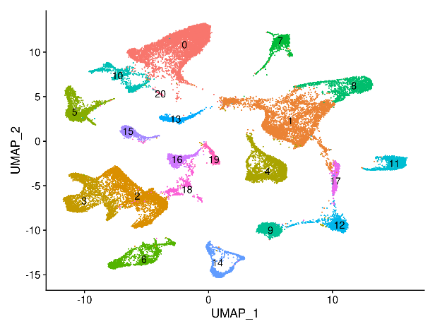
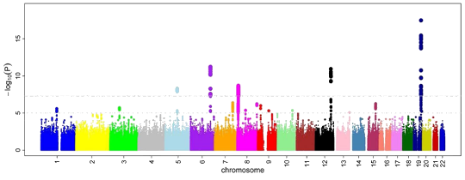
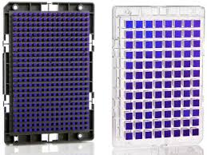
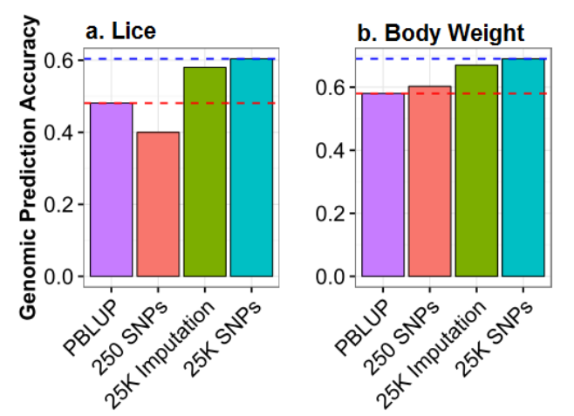
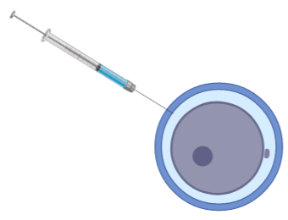
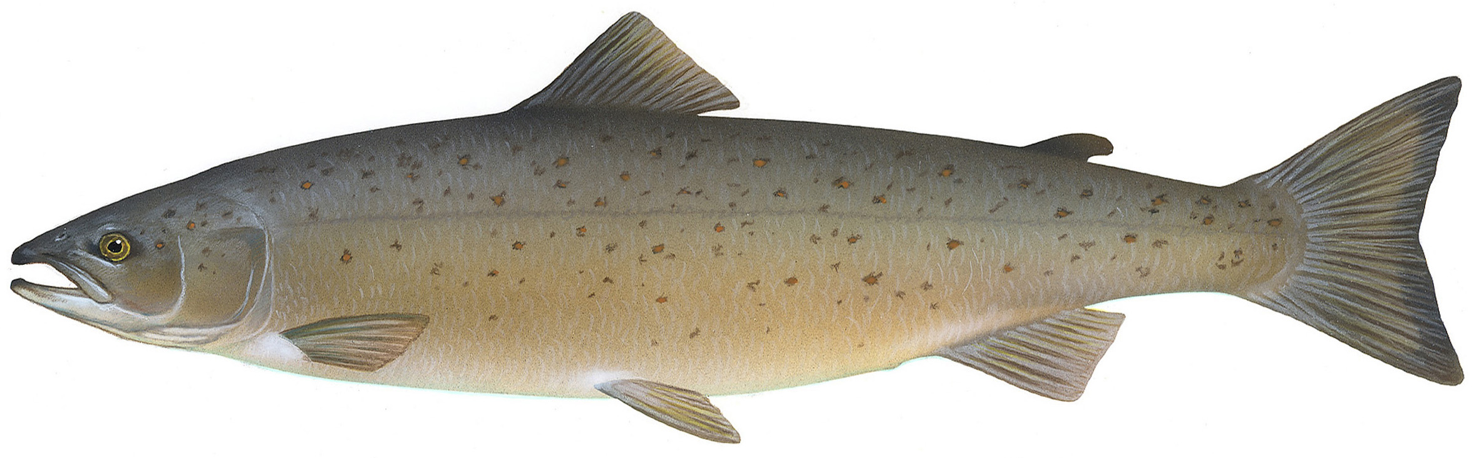
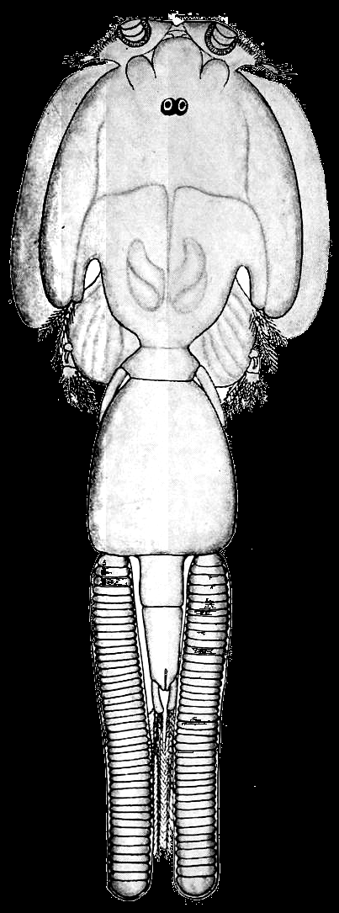
Tim: Association and selection could be merged to make room for something else if you want
Full spectrum of genetic and genomics research
Genome assemblies
Association analyses
Functional genomics
Genetic tools
Improve selection
Genome editing
susceptible
Resistant

Slide 8
Genome assemblies
Slides about oyster or mussel genome?

Slide 9
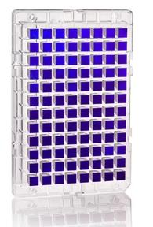
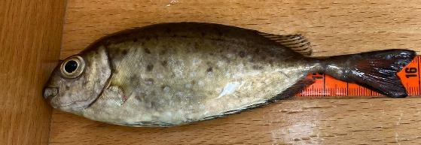
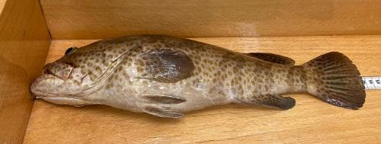
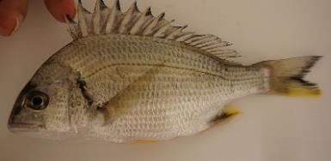
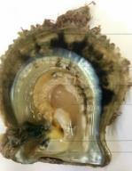
Tim: Qatari project?
Otherwise oysters or tilapia
Genetic tools
Species sampling plan developed in collaboration with Qatari scientists and MME
Safi (Siganus canaliculatus)
Hamour (Epinephelus coloide)
Spotted yellowfin seabream (Acanthopagrus sheim)
Pearl oyster (Pinctada imbricate radiata)

Slide 10
Genetic tools

Slide 11
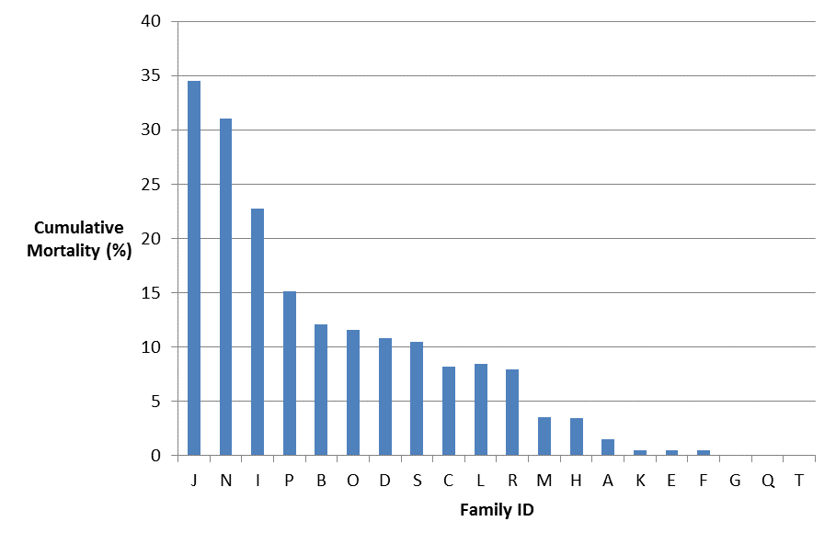
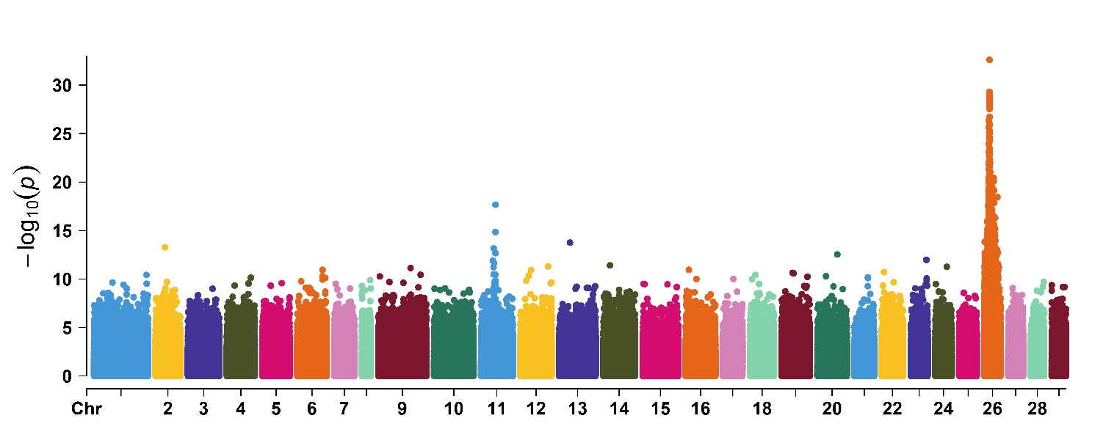

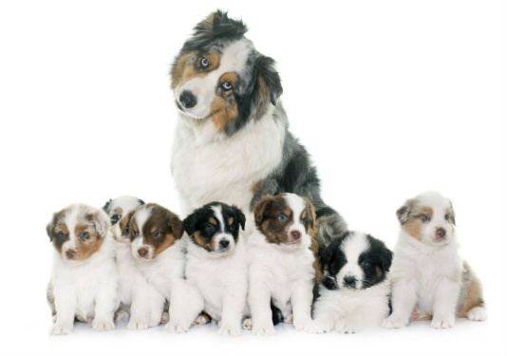
Association analysis
The curious case of resistance to IPNV in Atlantic salmon
Differences between families: genetic variation
GWAS & Manhattan plot: regions of the genome that explain those differences

Slide 12
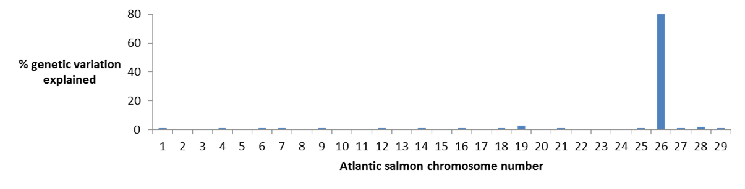
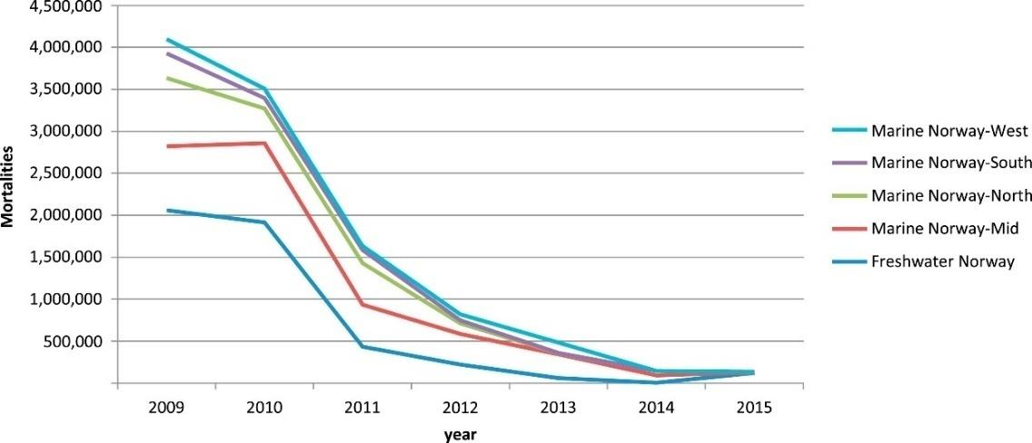
Association analysis
The curious case of resistance to IPNV in Atlantic salmon
One single “gene” in the salmon genome explains almost all the variation in resistance

Slide 13
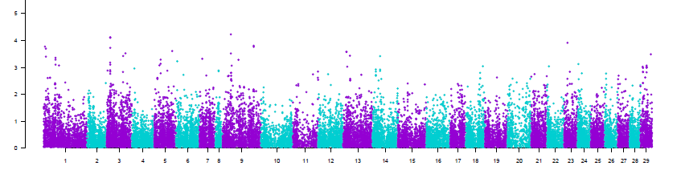
Improve selection
Most traits are polygenic
BLUP approaches
Sea lice resistance in Atlantic salmon

Slide 14
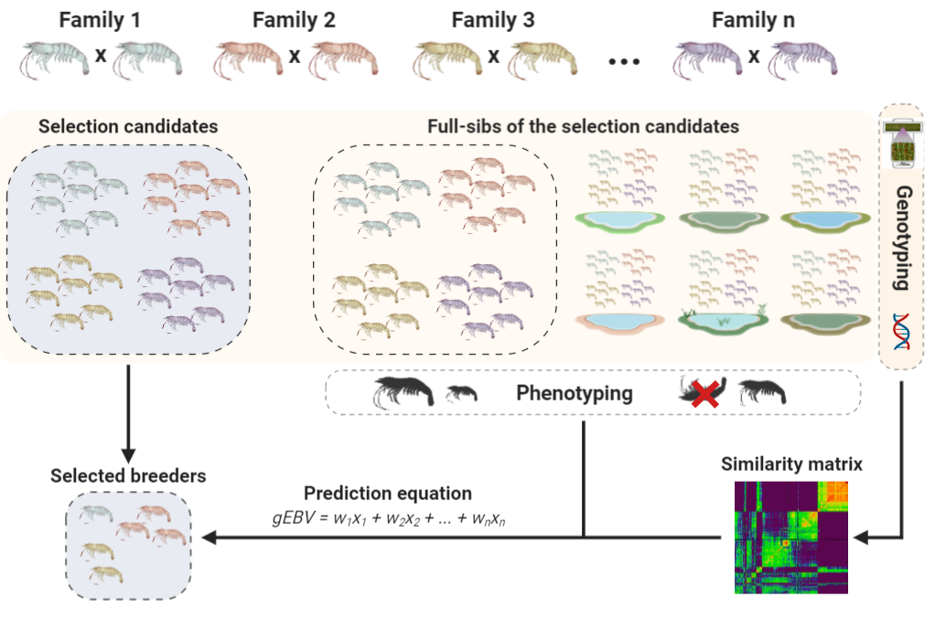
Genetics
Animal breeding

Slide 15
Genetics
Animal breeding

Slide 16
Genetics
Animal breeding

Slide 17
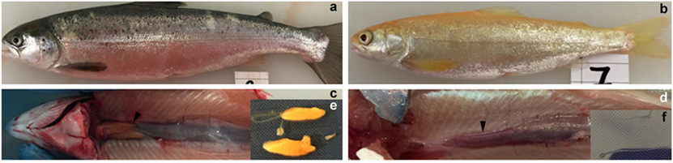
Genome editing
CRISPR/Cas9 successfully applied to salmonids, carp, tilapia, oyster, etc.
Knockout of dnd gene to induce sterility in salmon. Concurrent knockout of slc45a2 to produce albinos as a ‘tracer’ edit (Wargelius et al. 2016)

Slide 18
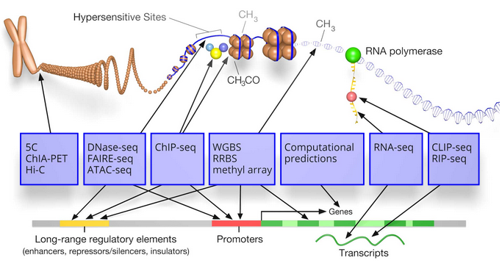
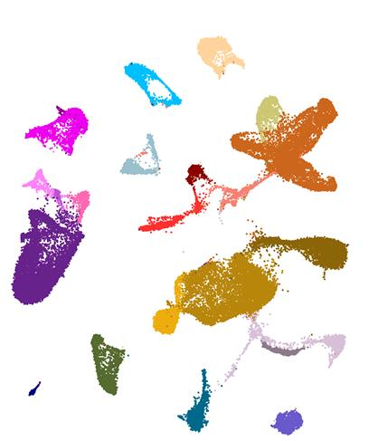
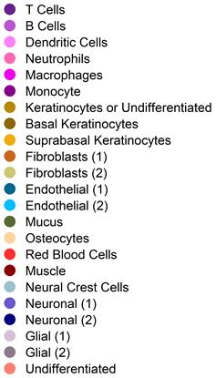
Functional Genomics
Atlantic salmon skin

Slide 19
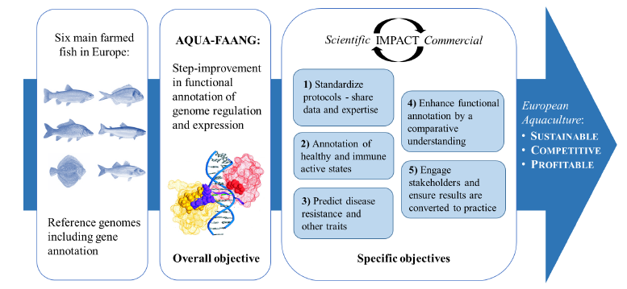

Functional Genomics

